Slide 1

Course Title: Computer Networks Laboratory Course Code: CSE 318 Assignment on ICT Ministry Network Design
Submitted by: Name: Ashiqur Rahman ID: 181472619 Batch: 47th Submitted To: Pranab bandhu Nath Senior lecturer of CSE at City University Submission Date: 11/22/2020

Slide 2
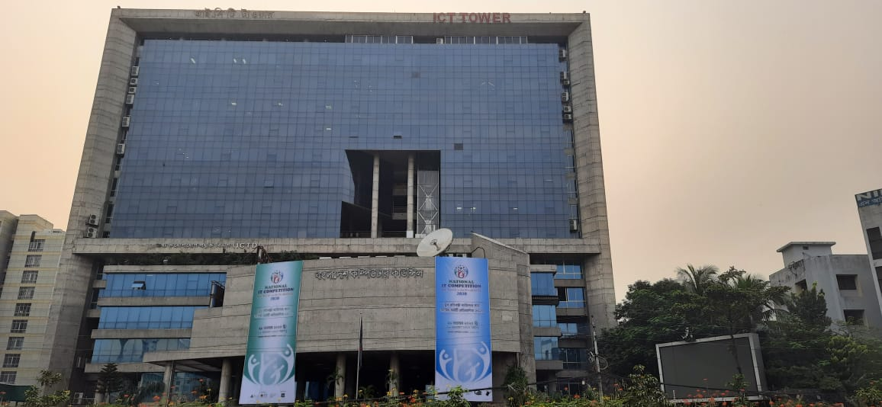
ICT Ministry (ICT Tower) Netwrok Design 2020

Slide 3
Table Of Content
About the Authors ...........................................................3
Executive Summary...........................................................4
Project plan.......................................................................5
obective ............................................................................6
scope of Work....................................................................7
Network System.................................................................8
Star Topology......................................................................9
Design & Feature ................................................................10
Logical Diagram...................................................................11
Physical Diagram ….....………………………………….... ……………….12
Security Requirement..........................................................13
Server System......................................................................14
Requirement .......................................................................15
Equipment Price...................................................................16
Connectivity ........................................................................17
Computer assemble & disassemble ......................................18,19

Slide 4

About the Author
I am Ashiqur Rahman. a student from City University.
I am completing my undergraduate program with bachelor of computer science and engineering.

Slide 5
EXECUTIVE SUMMARY
I’ve got a project from my computer Network course teacher to create a network design for ICT Ministry which is located in Agargaon, Dhaka. The client provides server fully depends on ICT. This is a greate oppertunity to create the etire network system for a Ministry.

Slide 6

Project Plan
The major objective of this project is to Implement the network of ICT Ministry in order to: · Design a network system that will be more efficient and more affective for the ICT ministry. · Provide increased network capacity · Provide future expansion capability. · Implement the network's fault tolerance, security, and high speed connection, · Identify the critical points of failure in the existing network and propose on how to eliminate them. · Find the network points error. So that should be fix without any hesitation.

Slide 7
Objectives
1.Scalability: The network design is scalable so that more network cable equipment can be added if needed.
2.Integration and Update: This is a new installation in ICT Tower . The network and equipment being installed will be new equipment designed specifically for ICT Ministry
3.Secure Service: The primary objective of this network is to provide secure network communication. It is designed to be functionally and physically isolated from access by unauthorized user.

Slide 8
Scope Of Work
The work that will be include the design and installation of a fully switched star network.
and some department has mesh topology
This includes the installation and setup of all the network devices, cabling and interfaces which include workstations, multi-function devices, servers, switches, routers, cabling and all related software as mentioned in the Requirement.

Slide 9
Network System
To create a best compatble network system to get the best services.
network topology is very importantfor create a network design.
for my ICT ministry project i am using most of the netwrok is Star topology. beacause for this ict tower there have so many department of ICT sector's. and these departmanet should be connected with each other. describe in next slide

Slide 10
Star Topology
Star topologies are common.it allow us to manage our entire network from a single location.
Because each of the nodes is independently connected to the central hub,switcch.
if one connection is fall down, the rest of the network will continue functioning unaffected,
making the star topology a stable and secure network layout.
Additionally, devices can be added, removed, and modified without taking the entire network offline.
On the physical side, the structure of the star topology uses relatively little cabling to fully connect the network, which allows for both straightforward setup and management over time.
The simplicity of the network design makes life easier for administrators, too, because it’s easy to identify where errors or performance issues are occurring.

Slide 11
Design & Feature
l Link to the connection to the internet Modem Firewall Switches 2 – 24 port switches will allow for providing security and speed Cable Management system to keep cables neat and organized. Cat 6 cable Computer LAB In the ICT Ministry most of the department has there LAB. For those LAB or training center’s computer are connected to the server with cat-6 network cable.

Slide 12
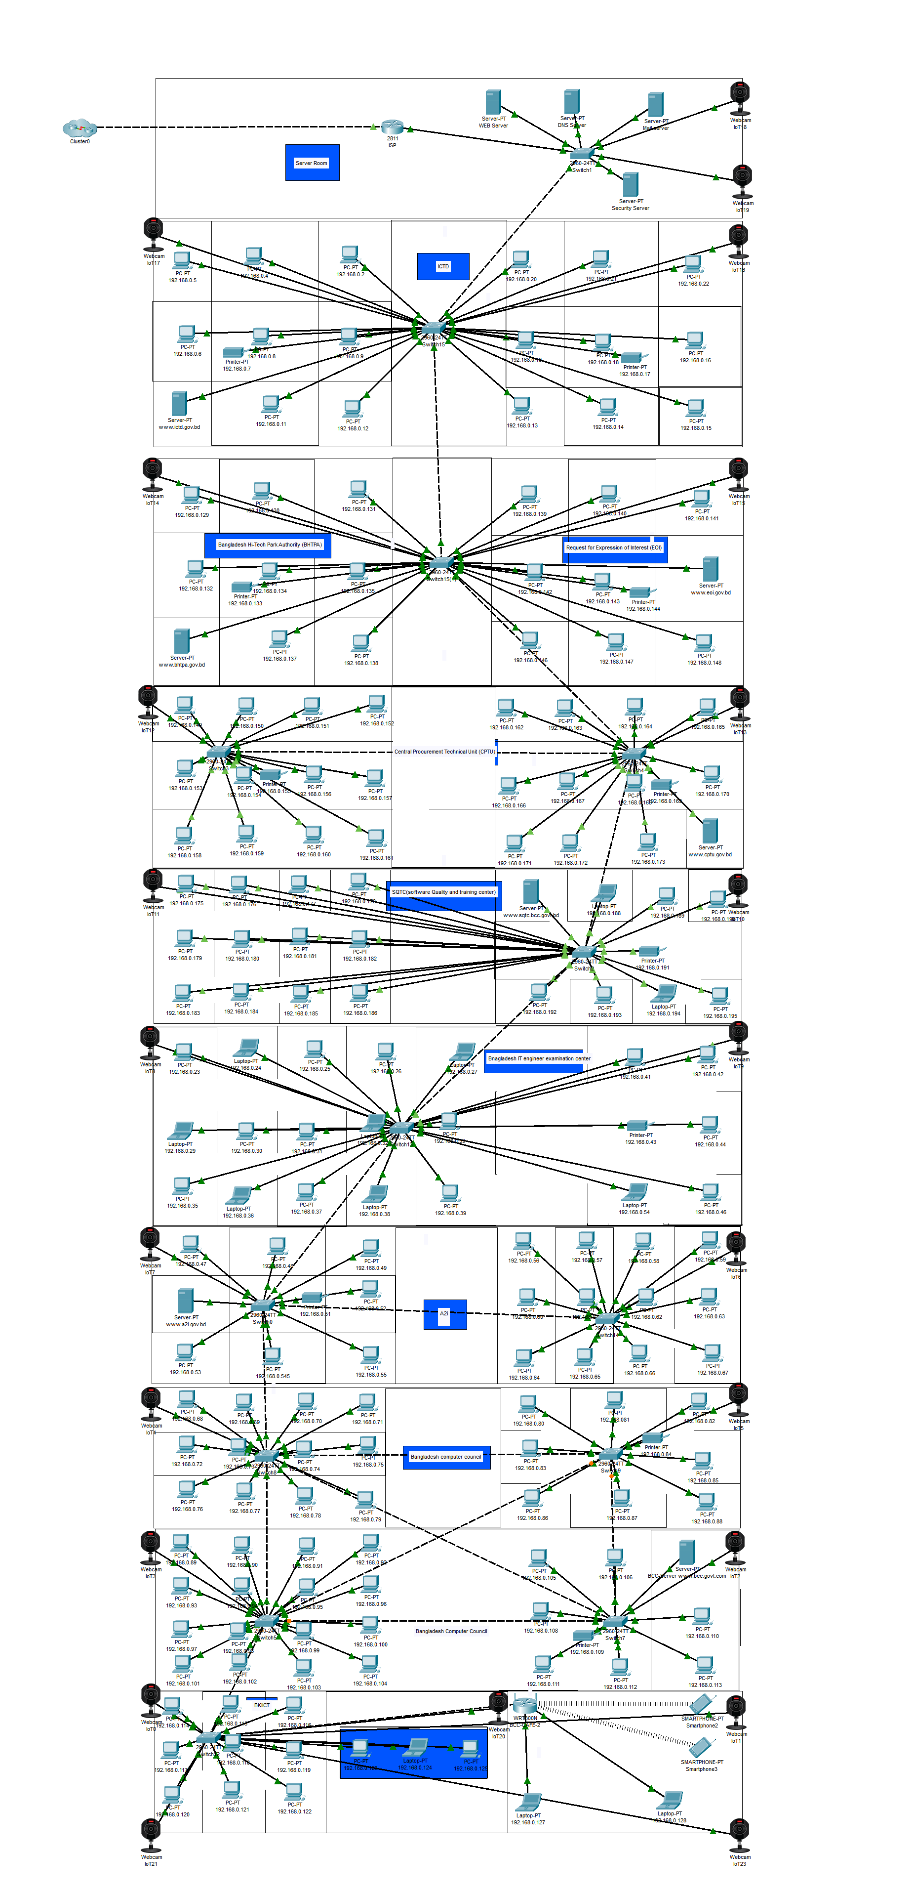
Logical Diagram

Slide 13
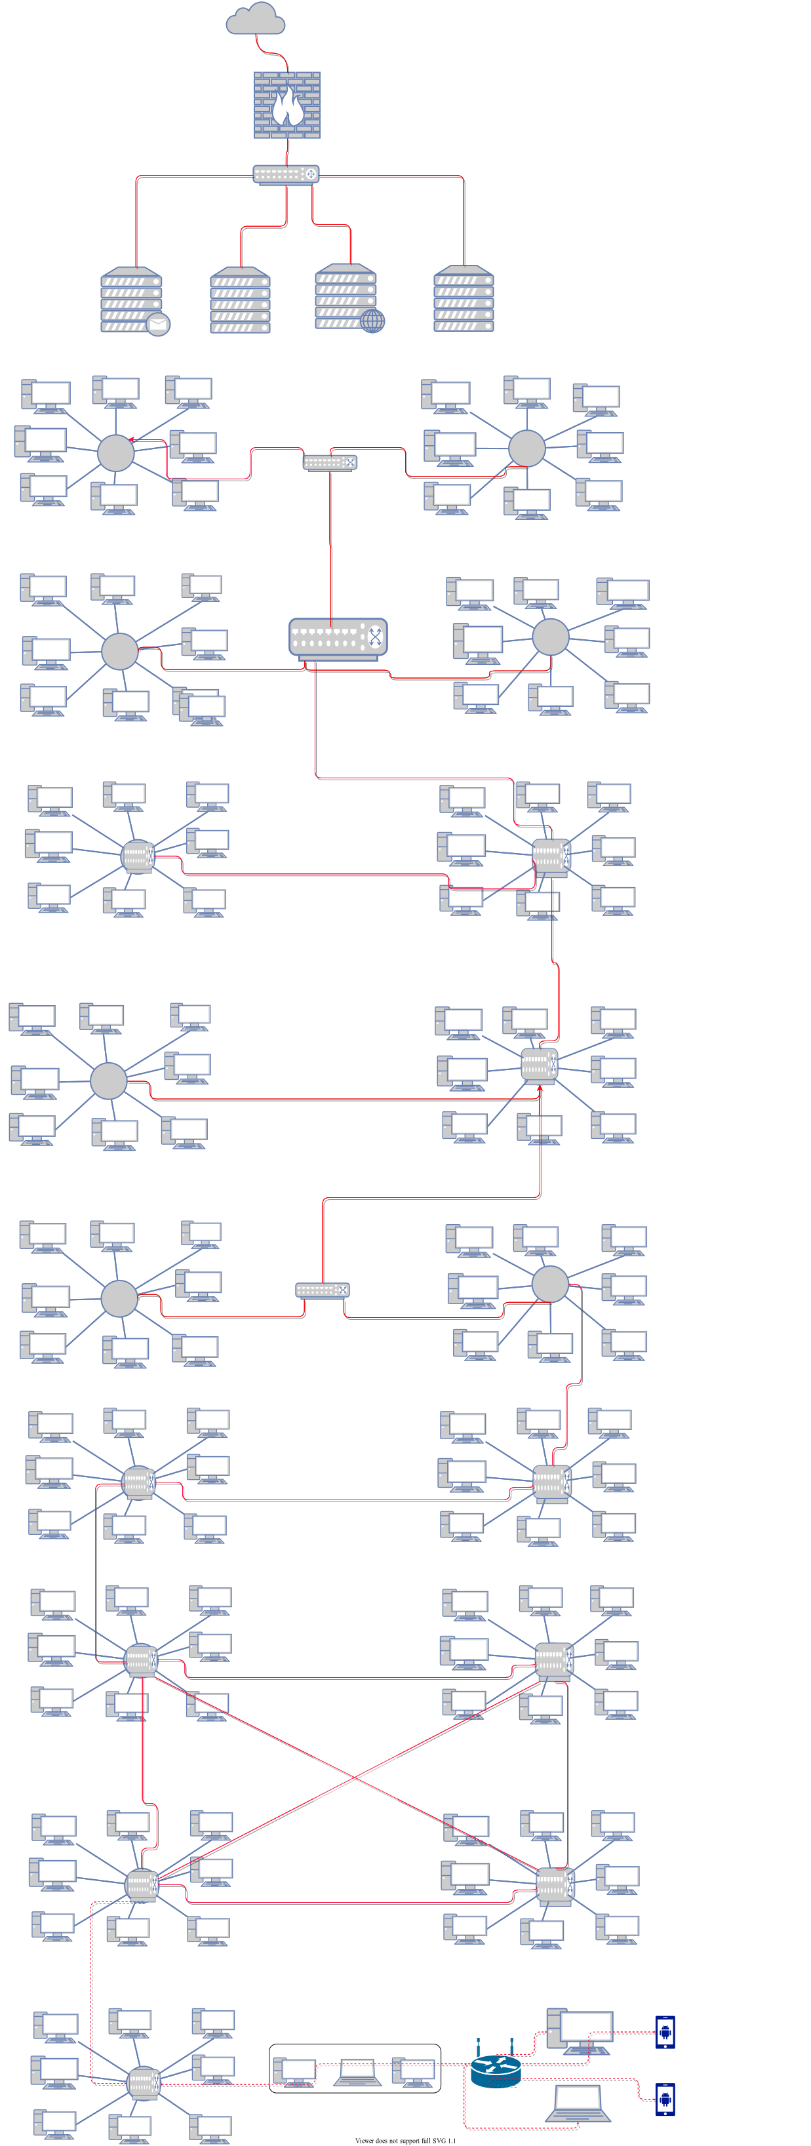
Physical Diagram

Slide 14

Security Requirement
For a Ministry there should have great security system. Like A firewall will be used so unauthorized use will be restricted. Part of the security will be user accounts and passwords that will give limited access. There will be different access capabilities for network managers and users. secure devices, password protected, and monitoring system,

Slide 15

Server System
For every Ministry or company
should have there own server system. similarly ICT Ministry
also has some server like
Mail Server
DNS Server
Web Server
File server
Security Server

Slide 16
Requirement’s
• Software • Microsoft Windows 10 Professional on all computer workstations • Microsoft Server 2019 on the server (network operating system) • AVAST Anti-virus software on all servers administrative and also for LAB • Microsoft Office 2020 • All updates and service packs installed • Multi-function devices (print, copy, fax, scan) • Switches • Wireless access points • Cabling and connectors(RJ-45) • All connections as needed • Workstations • Server • Router • Firewall • CCTV

Slide 17
Equipment price
Hardware | Per Unit Cost | Quantity | Total Cost
Cisco 2811 Integrated Services Router | 42394 | 1 | 42394
Cisco Catalyst 6509-E Switch | 36,500 | 14 | 511000
CISCO IOT WEBCAM | 3500 | 20 | 70000
Copper Straight Through Cat6 Utp Network Cable | 5500/roll | 10 | 55000
D-link Cat-6 RJ45 Cable Connector | 13.75 | 250 | 3437
linksys wrt300N router | 4000 | 1 | 4000
Dell EMC PowerEdge T140 8GB Tower Server | 110,000 | 11 | 7,297,334
Total price : 7,983,165

Slide 18
Connectivity
SMTP mail servers: Act as a relay between the Internet and the intranet mail servers. · DNS servers: Serve as the authoritative external DNS server for the enterprise and relay internal DNS requests to the Internet. · Firewalls: Provide network-level protection of resources, provide stateful filtering of traffic, and forward VPN traffic from remote sites and users for termination

Slide 19
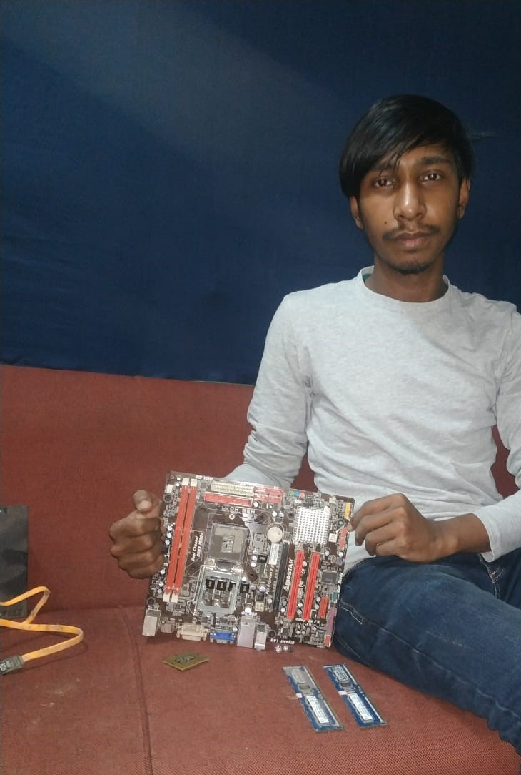
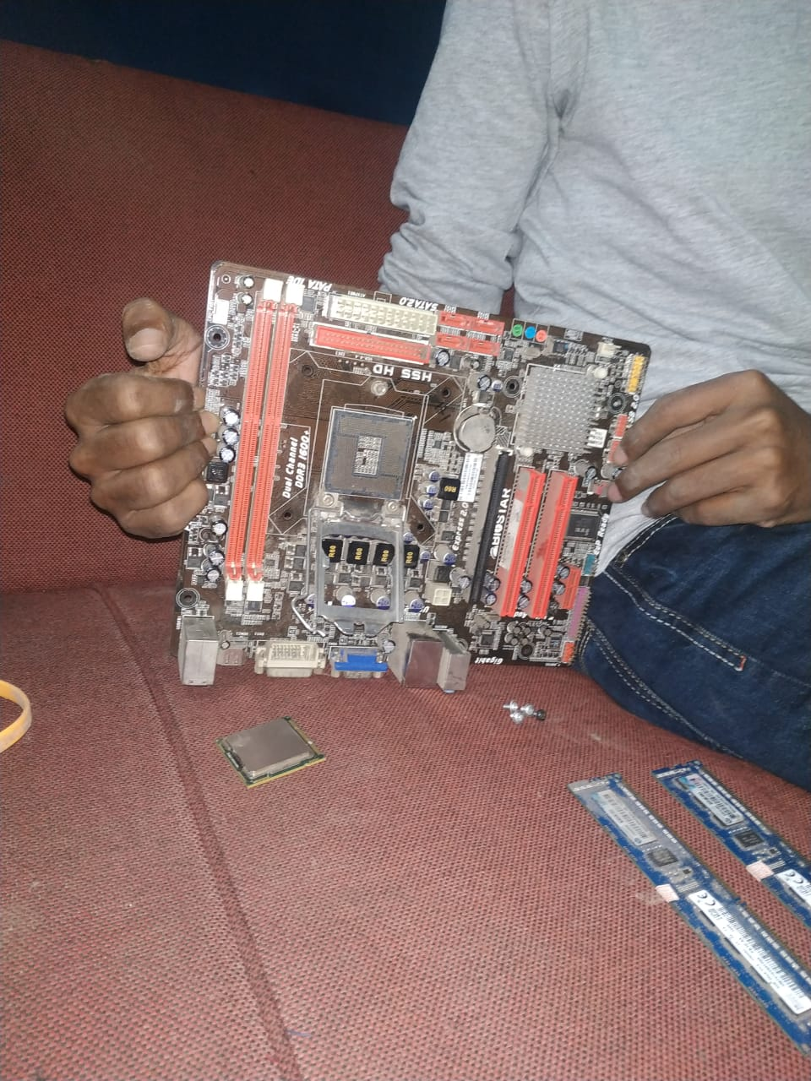
Computer assemble and Disassemble

Slide 20
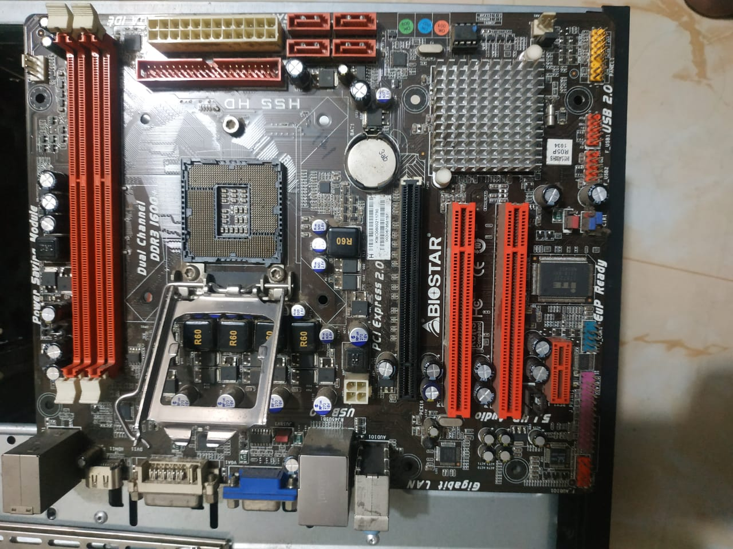
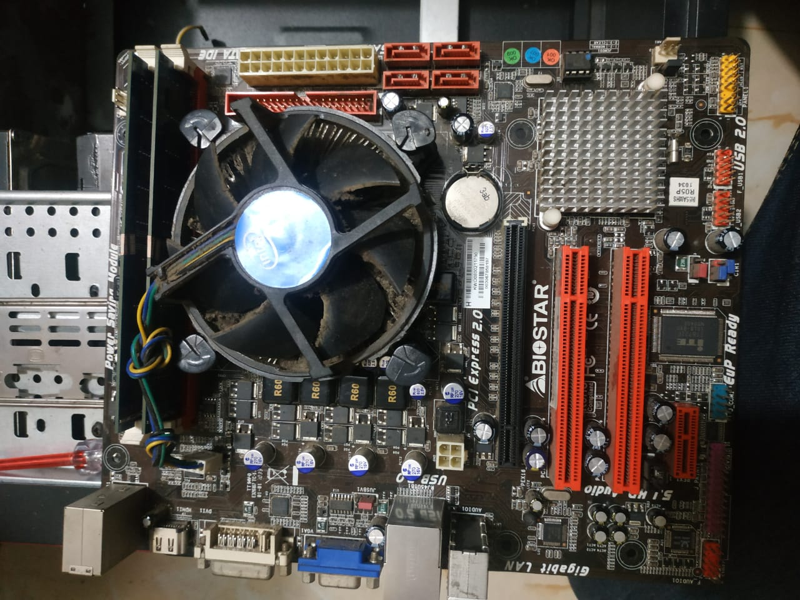

Slide 21
Thank You!

